Slide 1



Add-On Course Web Development on “ Natural Disaster Management “
||JAI SRI GURUDEV||
DEPARTMENT OF COMPUTER SCIENCE & ENGINEERING
ADICHUNCHANAGIRI INSTITUTE OF TECHNOLOGY,CHIKKAMAGALURU
Under the Guidance of
Prof. Arpitha.C.N .,_{B.E., M.Tech.,M.I.E}
Assistant Professor
Dept. of CS&E
Under the External Guidance of
Mr. Rajashekar .,B.E
Managing Director,
E-swara Technology
Presented By
Chethan Naik H S (4AI21CS020)
Diwakar N (4AI17CS029)
Koushik R (4AI17CS048)
Yashwanth R (4AI17CS122)
Shashank B S (4AI21CS127)

Slide 2
Agenda
Introduction about the project
Hardware and software requirements
Code with explanation
Screenshots
Results
Conclusion

Slide 3
I. INTRODUCTION
The past disaster management systems are widely existing at many places due to some disadvantages. However our web application for disaster management have
a)Prediction
b)increased searching speed
c)predict the exact location of concern areas
e)user can search for the helpline at any point of time.
This web page is used for disaster management for public welfare and efficient management of disaster.
Recent natural disaster have highlighted the need for disaster.
This web page helps the people who had lost their home, properties etc. by providing them funds collected from donators
People can access this web at any time at anywhere .
This web page have interface that provide easier communication.

Slide 4
II.Hardware and software requirements
CODE EDITIOR(VS CODE)
Google Maps
HTML
CSS

Slide 5

WHAT IS HTML ?
HTML stands for Hyper Text Markup Language
It is the standard markup language for creating Web pages
It describes the structure of a Web page
It consists of a series of elements
It elements tell the browser how to display the content
HTML elements label pieces of content such as "this is a heading", "this is a paragraph", "this is a link", etc.

Slide 6

WHAT IS CSS ?
CSS stands for Cascading Style Sheets.
It describes how HTML elements are to be displayed.
This style sheet language is used for defining the presentation of a document written in some markup language like HTML

Slide 7

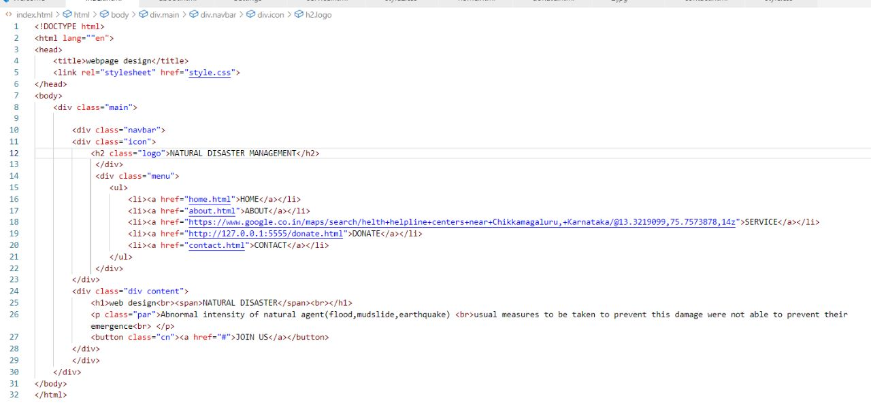
Front Page:

Slide 8
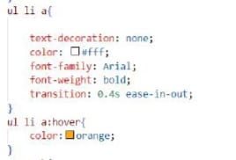

CSS:

Slide 9
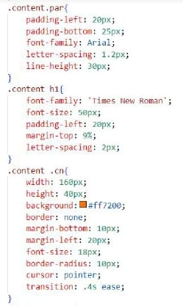

CSS:

Slide 10
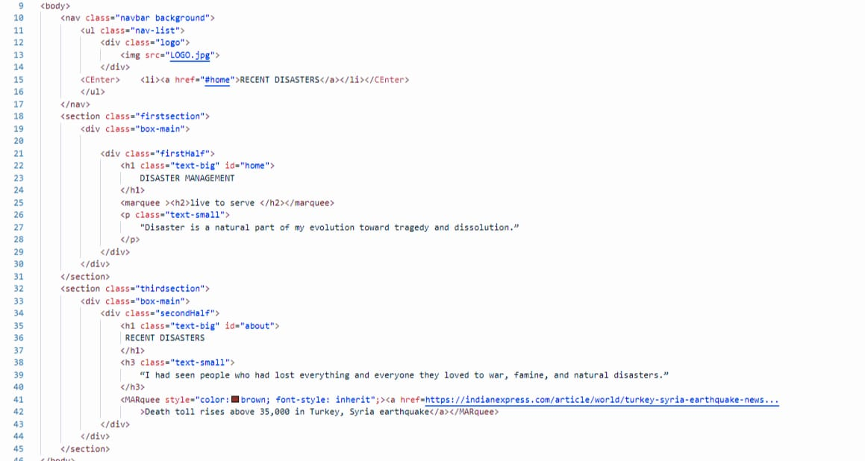
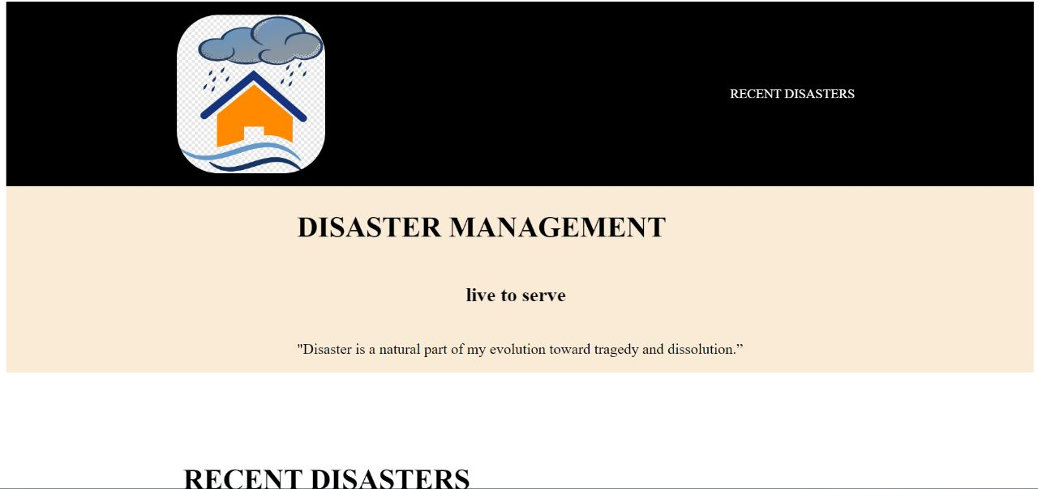
Home Page:

Slide 11
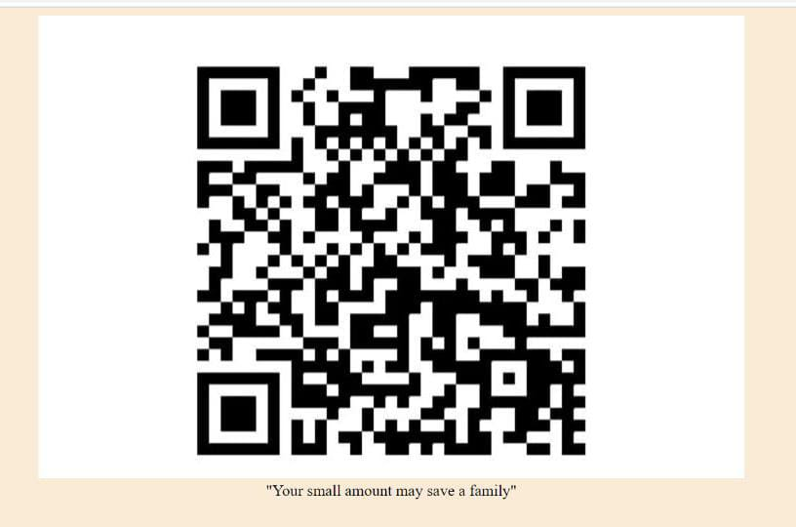
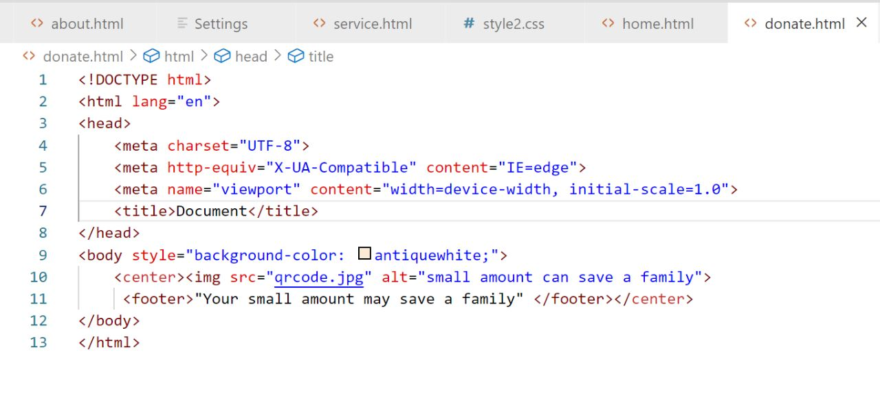
Donate:

Slide 12
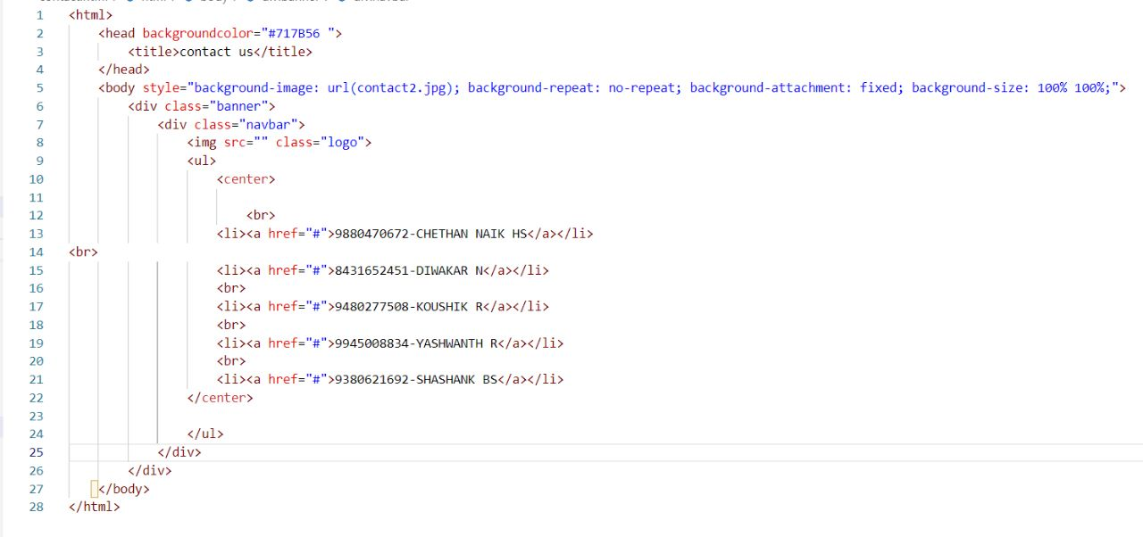

Contact :

Slide 13
Conclusion
Disaster: the common enemy to raise awareness of the importance of working across the divide to improve disaster management.
As well as making disaster management more effective, and therefore potentially saving thousands of lives, a shared response could help build confidence between different groups and peoples
and support them.

Slide 14
Reference
Google
Trip Editor app
Indian Express news paper
National Disaster Management Authority page
Disaster Management Department
National Platform For Disaster Risk Reduction

Slide 15


